Slide 1


Transportation and the Environment

Slide 2
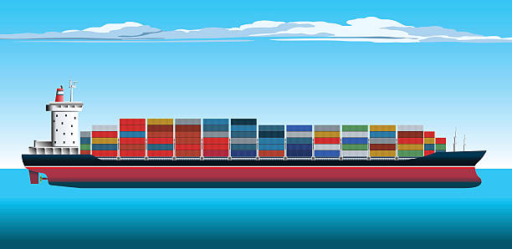
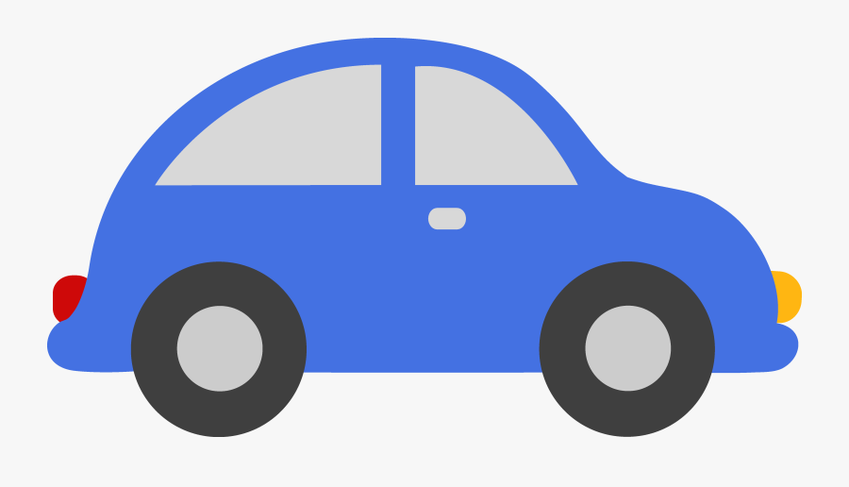

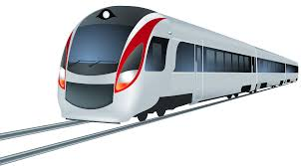

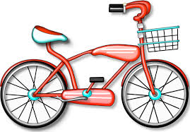
What is transportation?
The movement of people or goods from one place to another.

Slide 3

Let’s rate these on how green they are
1 is greenest or best for the environment and 5 is worst
Transportation Type | Ranking
Bicycle
Hybrid or Electric Car
Planes
Regular Cars
Bio-diesel Powered Truck
Bus
Sail Boat

Slide 4
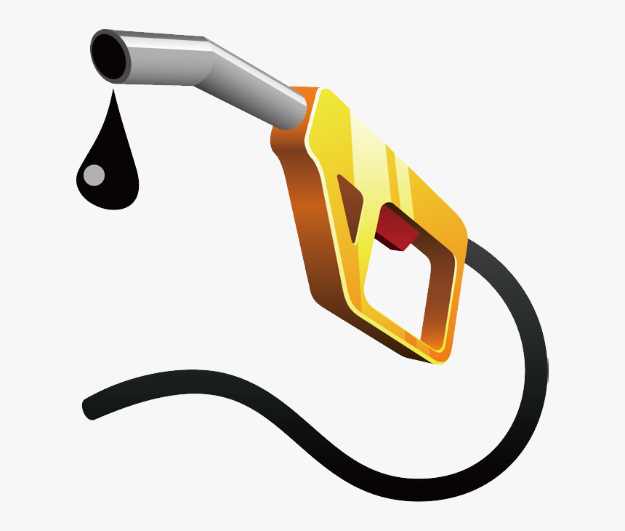
Transportation Fuels
Gasoline and diesel are fossil fuels which are
  Non-renewable
  Meaning they are used once and gone
Biofuels, solar power, and people power are fuels which are
  Renewable
  Meaning they are replenished to be used again

Slide 5
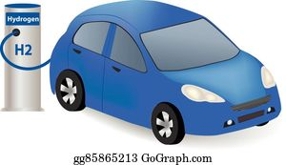
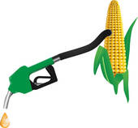

Renewable Fuels for Vehicles
Hydrogen
Ethanol
Solar power

Slide 6
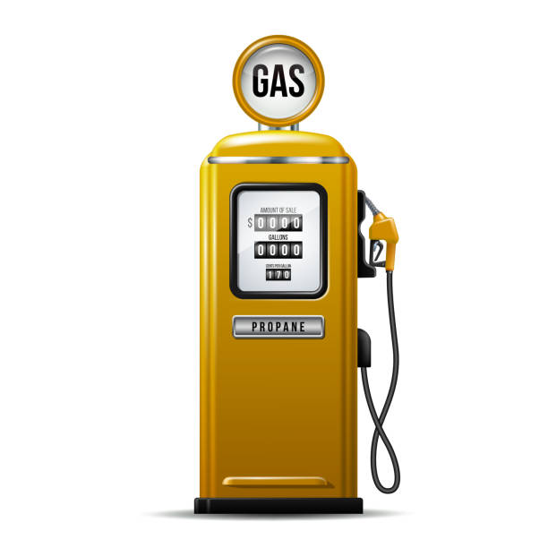
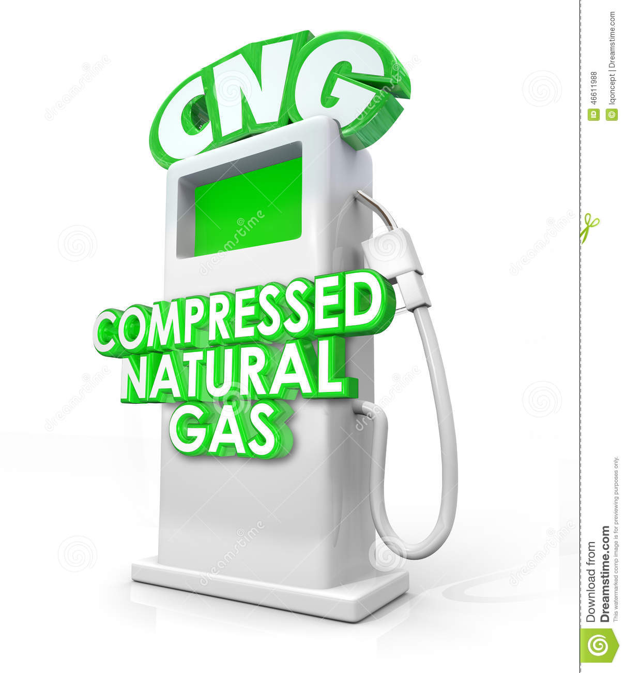
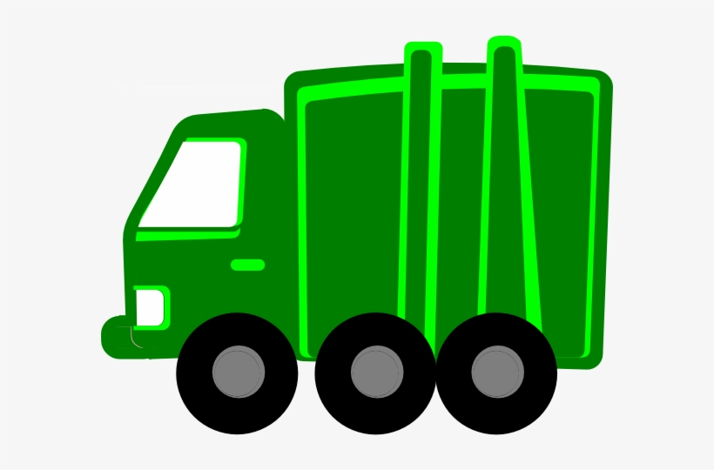
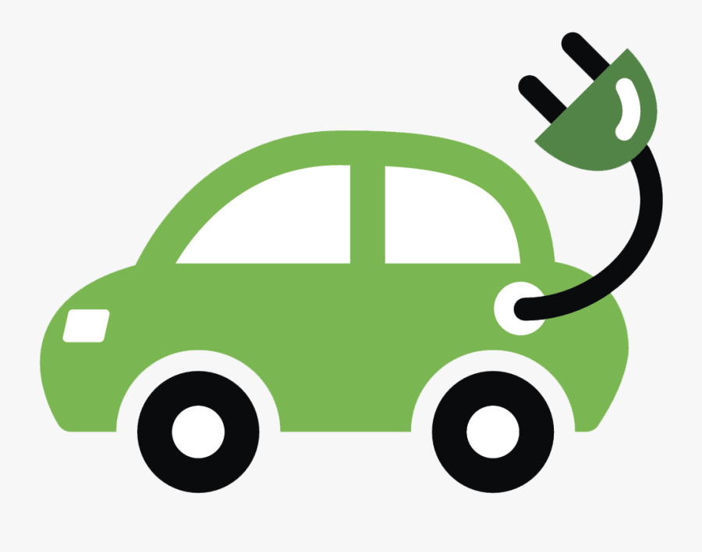
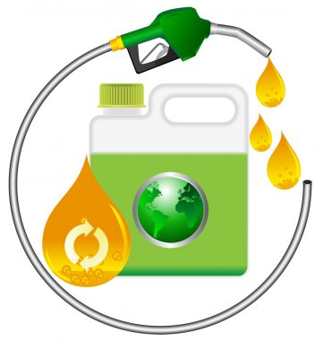
Non-Renewable but Green
Fuels for Vehicles
propane and natural gas
electricity
biodiesel

Slide 7
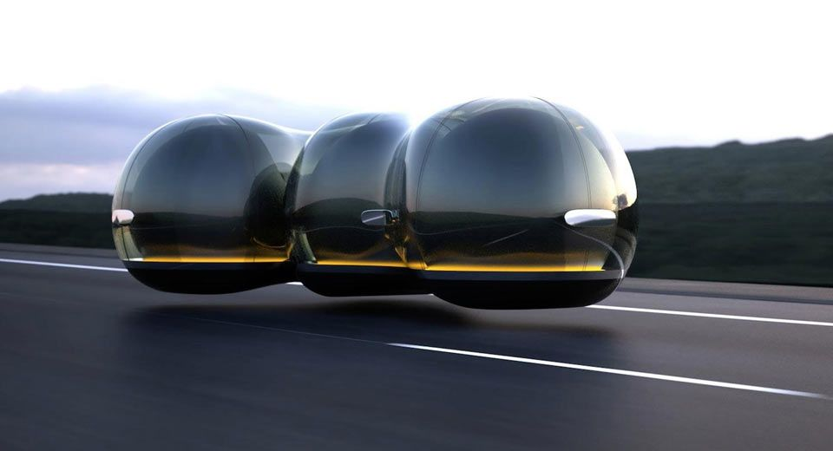
You have a challenge!
You are an engineer who has to design a new form of transportation that is better for the environment than what we have now.
  Must have 2 features that will decrease pollution
  Must carry passengers or supplies from one place to another quickly
How will you know what to do?
  Let’s look at what you have learned so far

Slide 8
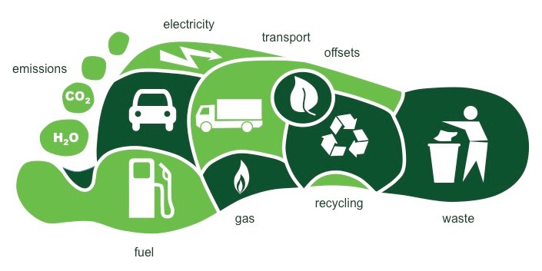
Carbon Footprint
There are things that you do each day that contribute to carbon in the atmosphere
Burning fossil fuels adds carbon to the atmosphere as greenhouse gases
Greenhouse gases trap heat in the atmosphere
When greenhouse gases are out of balance, it causes climate change
  Increased temperature on Earth
  More extreme weather and changes to global climate

Slide 9

Air Quality
What is in the air we breathe?
  Visible – smoke, smog, water vapor
  Invisible – small particles, greenhouse gases, oxygen we need to breathe
Clean air is critical to our health
  Air pollution contributes to asthma and lung and heart diseases

Slide 10
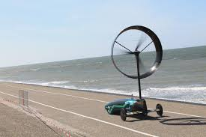
Design Eco-Friendly Transportation
You are an engineer who has to design a new form of transportation that is better for the environment than what we have now.
  Must have 2 features that will decrease pollution
  Must carry passengers or supplies from one place to another quickly
Use the Transportation From the Future Checklist
  Draw your design
  Explain what makes it green and how it reduces pollution
  Why should people choose your transportation?

